Slide 1

Process Mining Virtual Internship
Process Mining Virtual Internship
by
C.VAISHNAVI
Roll No. 224G1A32A7
Department of Computer Science and Engineering(Data Science)
Srinivasa Ramanujan Institute of Technology
Autonomous
Rotarypuram Village, B K Samudram Mandal, Ananthapuramu – 515701.
2024-2025
224G1A32A7
Dept.Computer Science & Engineering(Data Science)
Srinivasa Ramanujan Institute Of Technology
1

Slide 2
Process Mining Virtual Internship
All India Council for Technical Education (AICTE) has initiated various activities for promoting industrial Internship at the graduate level in technical institutes
Edu-Skills is a Non-profit organization which enables Industry 4.0 ready digital workforce in India.
The vision of the organization is to fill the gap between Academic and Industry by ensuring world class curriculum access to the faculties and students.
Formation of the All-India Council for Technical Education (AICTE) in 1945 by the Government of India.
The main mission of these initiatives is enhancement of the employability skills of the students passing out from Technical Institutions.
2241A32A7
Dept.Computer Science &Engineering(Data Science)

Slide 3

Contents
Process Mining Virtual Internship
Introduction
Modules
Modules Explanation
Conclusion
References
2241A32A7
Dept.Computer Science &Engineering(Data Science)

Slide 4
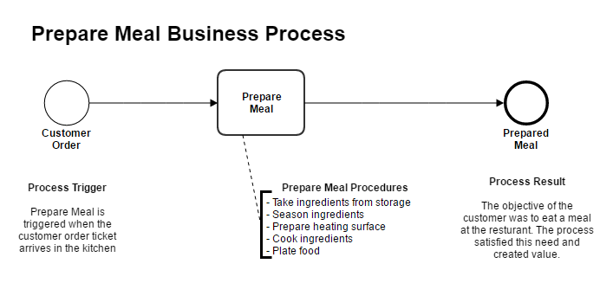
Introduction
Process Mining Virtual Internship
Process
A process is very simply a series of linked actions or steps taken in order to achieve particular goal.
The process must involve clearly defined inputs and a single output.
For example:
Process
224G1A32A7
Dept.Computer Science & Engineering(Data Science)

Slide 5
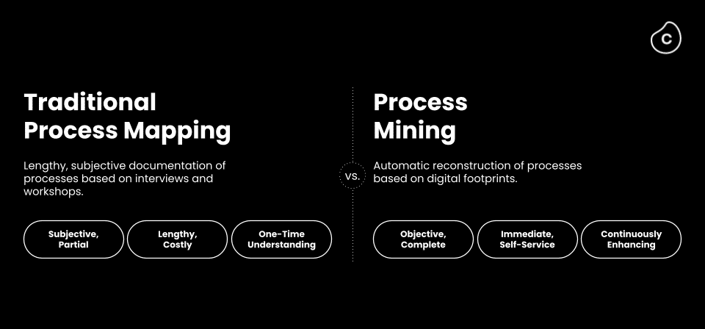
Introduction
Process Mining Virtual Internship
Process mining is a widely-used technology to model, analyze, and optimize business processes, shows how your processes actually run.
Traditional approaches fail to understand the real-life complexity of processes and also struggle to provide complete insights and visibility given the vast amounts of data that are now available.
Process Mining is a solution to costly and time-intense efforts to get data-driven insights into a business
Traditional Process Mapping vs Process Mining
224G1A32A7
Dept.Computer Science & Engineering(Data Science)

Slide 6
Modules
Process Mining Virtual Internship
Introduction to Process Mining
Process Mining Fundamentals
Rising Star Technical
Write PQL Queries
Get Data into the EMS
224G1A32A7
Dept.Computer Science & Engineering(Data Science)

Slide 7
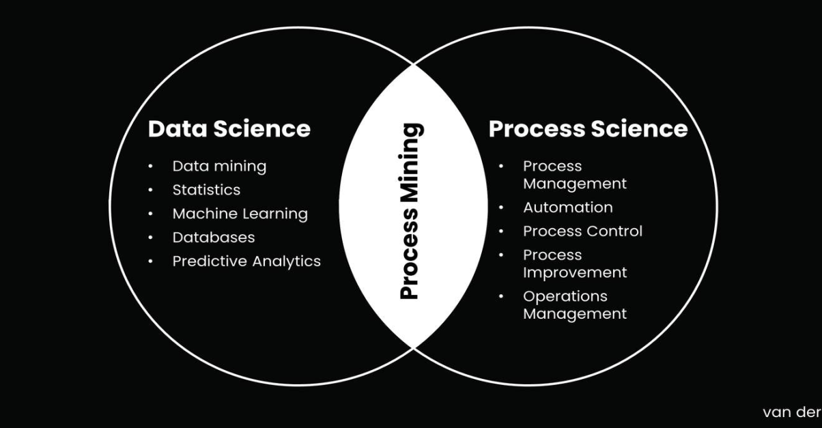
Introduction to Process Mining
Process Mining Virtual Internship
Process Mining is the combination of two disciplines: Data Science and Business Process Management.
Process Mining
Data science is the study of data to extract meaningful insights for business.
Process science is an emerging scientific field concerned with studying the nature of change.
Process Mining provide insights, identify bottlenecks, anticipate problems.
224G1A32A7
Dept.Computer Science & Engineering(Data Science)

Slide 8
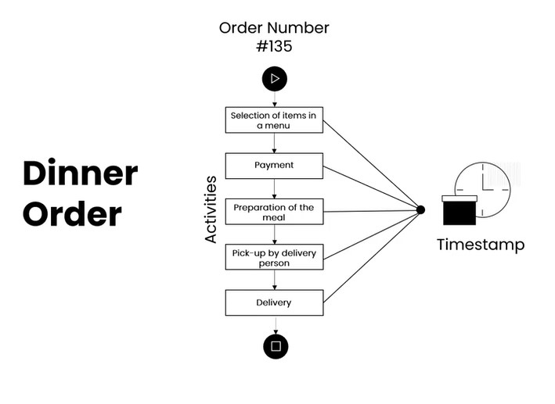
Digital Footprint
Process Mining Virtual Internship
Digital Footprint
This digital footprint will consist mostly out of a timestamp, an activity name and a case ID. This data is all captured and can be found in the Event Log, which is a record of everything that takes place in order to perform a task
224G1A32A7
Dept.Computer Science & Engineering(Data Science)

Slide 9
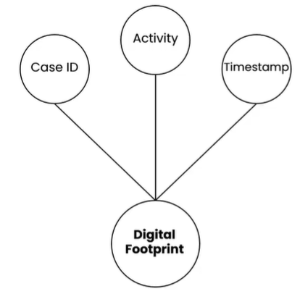
Event Log
Process Mining Virtual Internship
Event Log
Event Logs are the format in which we can retrieve our digital
footprints from the underlying IT systems.
An Event Log contains each of the three key pieces of information
that our digital footprints have:
A Case ID: A unique identifier such as a purchase order item, invoice number or order number.
An activity: The description of what has happened - for example, the creation of a purchase order or the receipt of goods.
Timestamp: The date and time that the activity took place.
224G1A32A7
Dept.Computer Science & Engineering(Data Science)

Slide 10
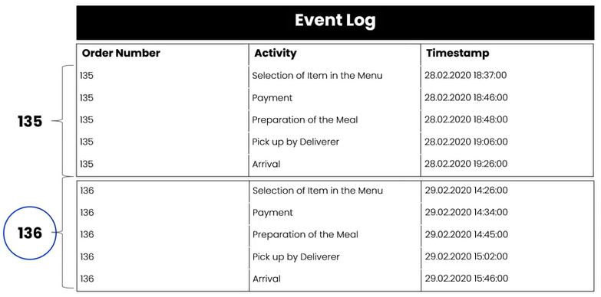
Introduction to Process Mining
Process Mining Virtual Internship
Only companies that embrace digital transformation and use data insights to optimize their processes will elevate their customer experiences and eventually drive business success.
With the help of these footprints, they can optimize, innovate, and accelerate their products and services.
224G1A32A7
Dept.Computer Science & Engineering(Data Science)

Slide 11
Process Mining Fundamentals
Process Mining Virtual Internship
Process Mining works by extracting knowledge from event logs (also called digital footprints) readily available in today’s information systems, in order to visualize business processes
When interacting with the dynamic visual representation one can take an exploratory approach or a confirmatory approach.
Exploratory Approach : An exploratory approach is one where you simply explore the data and see what value opportunities jump out at you. You’re diving into the data without specific expectations and with an open mind. Analysis tools such as the sthe Variant Explorer
Confirmatory Approach : With the confirmatory approach, you’re examining the data to see if it confirms or denies a hypothesis. Using your Celonis Analysis, specifically by filtering on attributes you can find out whether the data confirms or denies that these perceived pain points exist and have a significant impact.
224G1A32A7
Dept.Computer Science & Engineering(Data Science)

Slide 12
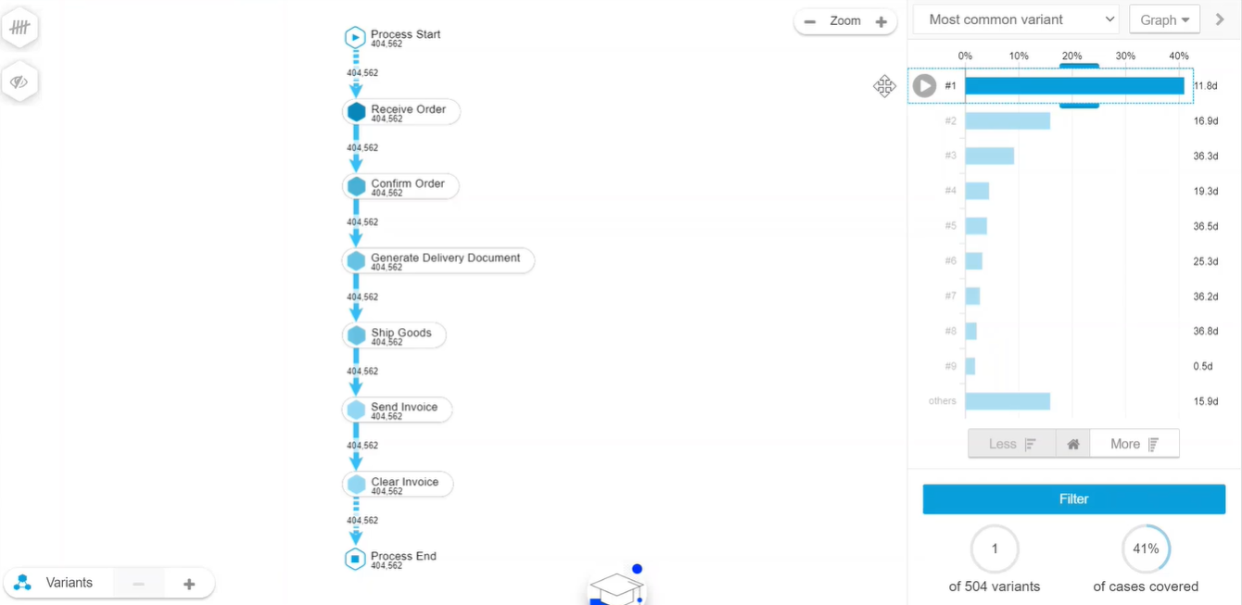
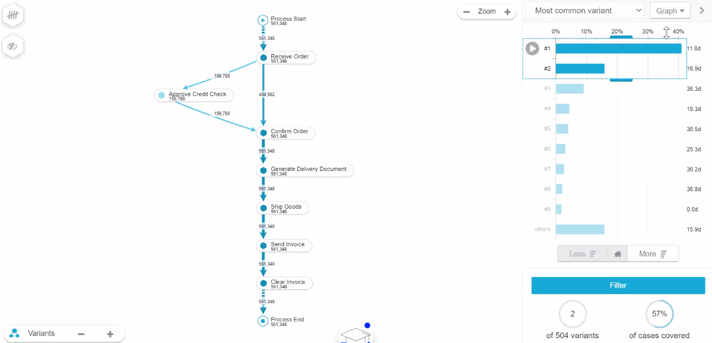
Variant Explorer
Process Mining Virtual Internship
As the name implies, using the Variant Explorer, you can discover all the process variants—that is all the different ways the process flows in your organization.
Variant Explorer with single variant Variant Explorer with two variant
224G1A32A7
Dept.Computer Science & Engineering(Data Science)

Slide 13
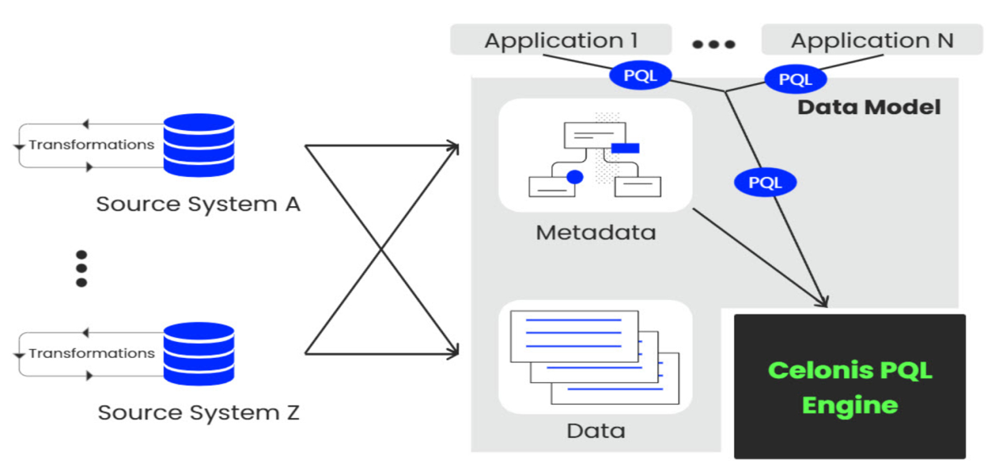
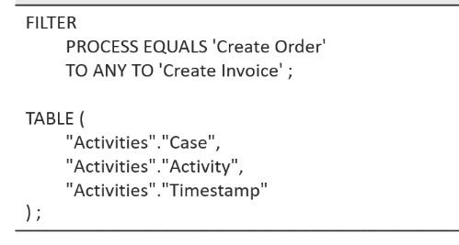
PQL Queries
Process Mining Virtual Internship
It is essential for Process Mining users to formalize their process questions as executable queries. For this purpose, we present the Celonis Process Query Language (Celonis PQL).
Celonis Software Architecture Process Query looks as follows:
Celonis PQL is an integral component of the Celonis Software Architecture. All Celonis applications use this language to query data from a data model.
PQL is a declarative language that is based upon temporal logic.
224G1A32A7
Dept.Computer Science & Engineering(Data Science)

Slide 14
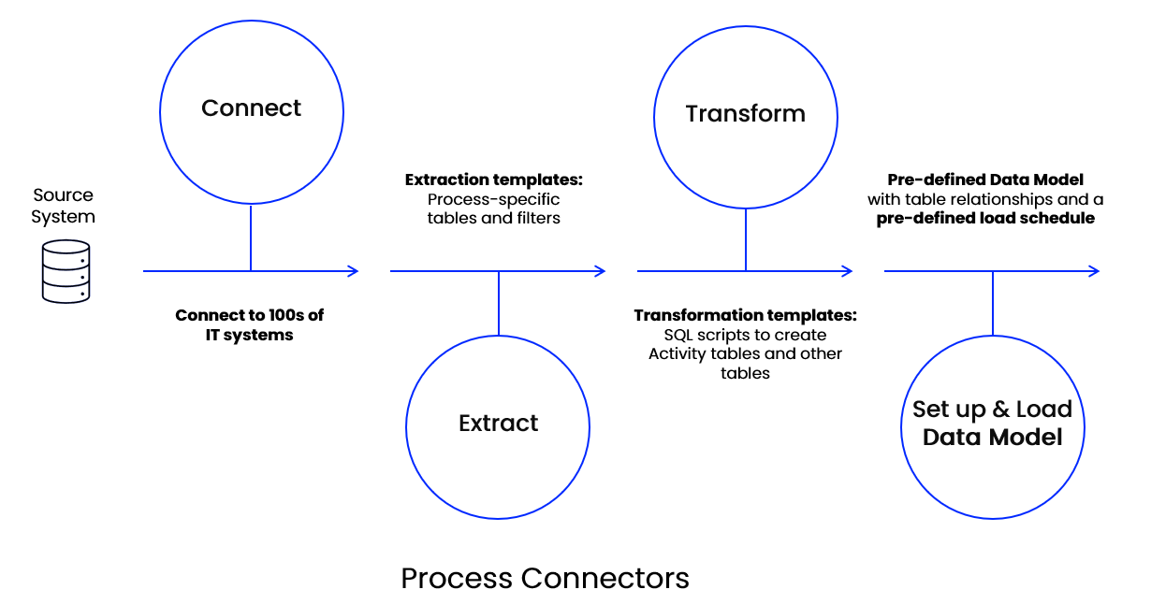
Get Data into the EMS
Process Mining Virtual Internship
Data Integration
Process Data is a set of connected activities with timestamps following one specific case, or object. Every activity is an "event", and your task is to collect these events and organize them in the right order.
It helps you connect to source systems, extract the relevant data, transform it to your needs, and load it into a polished Data Model.
224G1A32A7
Dept.Computer Science & Engineering(Data Science)

Slide 15
Get Data into the EMS
Process Mining Virtual Internship
Connect: Connecting to source systems is your very first step to pull process data into the Celonis EMS. The EMS utilizes a broad set of technologies like Restful APIs, Soap APIs, direct database access, to connect.
Extract: It refers to a process of retrieving or collecting specific data from various sources or systems and consolidating it into a unified format or database.
Transform: The goal is to transform your data so it can become a Process Data Model. Your most important task is to create the Activity table, also called the event log. This table is the basis for the Data Model you build to visualize your process flow.
Data Model: It is the process of creating a visual representation of either a whole information system or parts of it to communicate connections between data points and structures.
224G1A32A7
Dept.Computer Science & Engineering(Data Science)

Slide 16
Get Data into the EMS
Process Mining Virtual Internship
Execution Management System (EMS): An Execution Management System (EMS) in Celonis Process Mining is a tool that helps organizations optimize and improve their business processes by providing real-time visibility, control, and automation.
Celonis Process Mining helps you understand how these processes actually work by analyzing the data generated during their execution.
It helps to monitor, control, and optimize your business processes as they are happening, ensuring they run smoothly and efficiently.
224G1A32A7
Dept.Computer Science & Engineering(Data Science)

Slide 17
Conclusion
Process Mining Virtual Internship
Celonis process mining is like having a superpower for understanding and improving how things work in a business. It helps companies see exactly what's happening in their processes, like how employee's complete tasks or how customers are served. With this information, businesses can make smarter decisions, find bottlenecks, and fix problems faster. So, Celonis process mining is a valuable tool for making organizations run more smoothly and efficiently.
224G1A32A7
Dept.Computer Science & Enginnering(Data Science)

Slide 18
References
Process Mining Virtual Internship
https://academy.celonis.com
https://appian.com/process-mining
224G1A32A7
Dept.Computer Science & Engineering(Data Science)

Slide 19
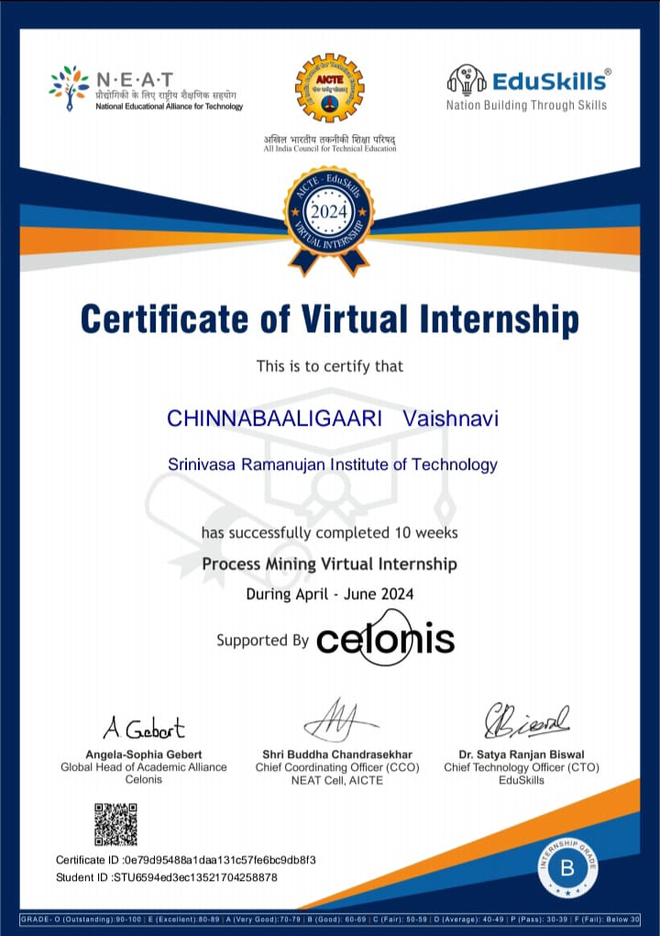
Internship Certificate
Process Minning Virtual Internship
224G1A32A7
Dept.Computer Science & Engineering(Data Science)
20

Slide 20
Process Mining Virtual Internship
Thank You!!!
22G1A32A7
Dept.Computer Science & Engineering(Data Science)

